Slide 2
Future of Istio - Sidecar, Sidecarless or Both
Apr 20, 2023
Neeraj Poddar

Slide 3
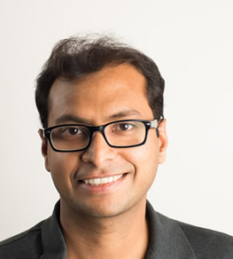
Speaker
Neeraj Poddar
Head of Engineering, Solo.io
Istio TOC & former Steering Committee member
@nrjpoddar
LinkedIn

Slide 4
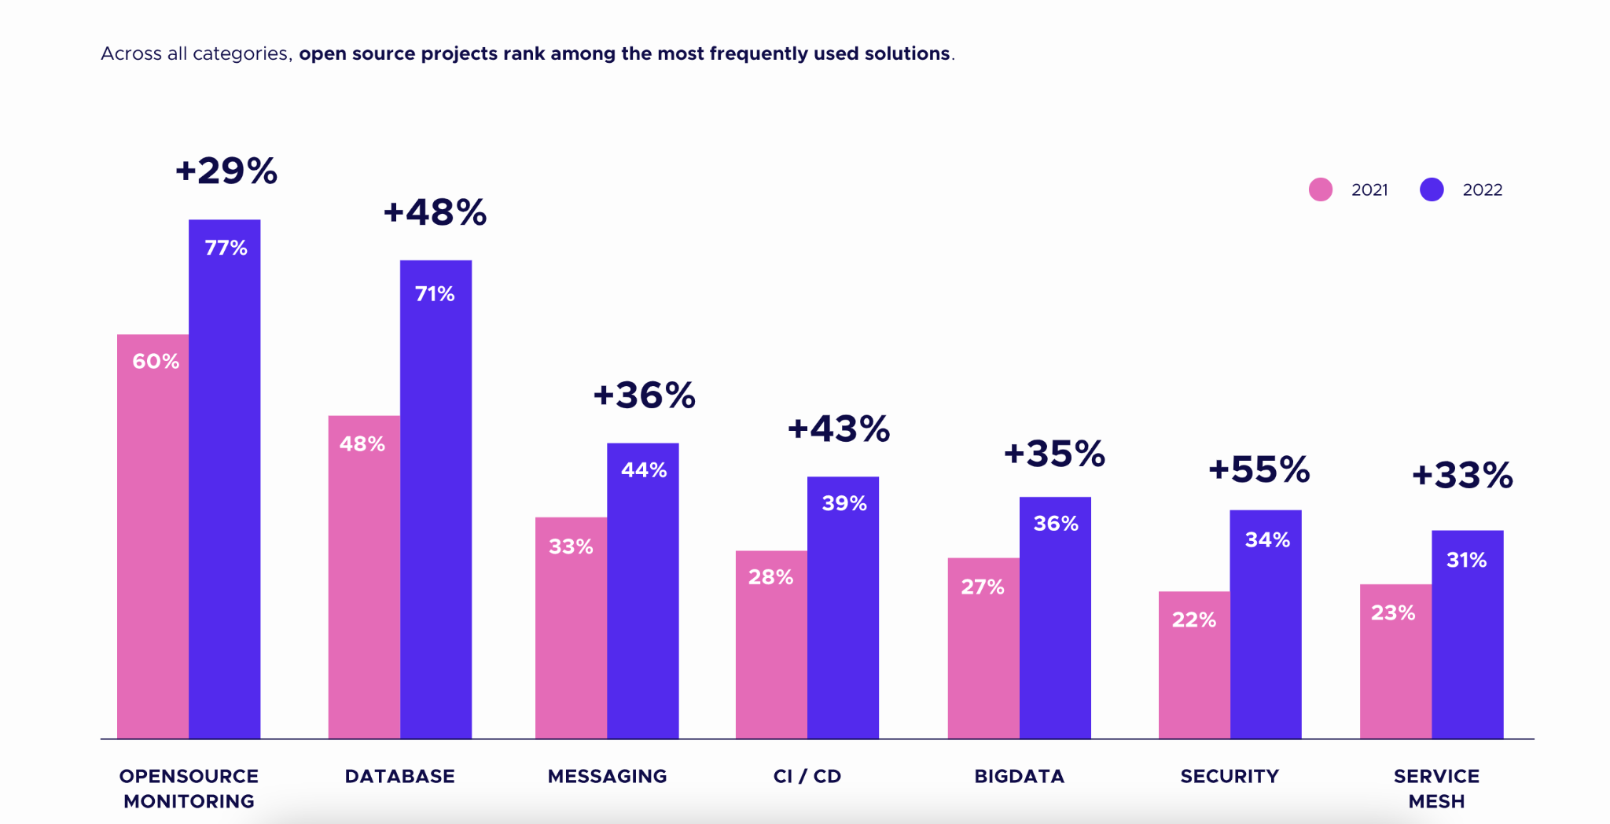
Kubernetes Growth Areas
Reference: CNCF 2022 Annual Survey

Slide 5

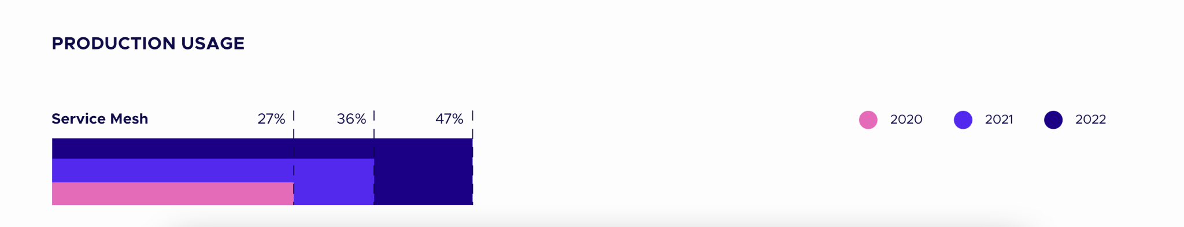
Service Mesh Adoption
Reference: CNCF 2022 Annual Survey

Slide 6

Thriving Istio Community
412 Active Members and counting!
59 maintainers
13 Working Group Leads
6 TOC members from 4 organizations
13 Steering members from 8 organizations
410 contributing companies
Reference

Slide 7
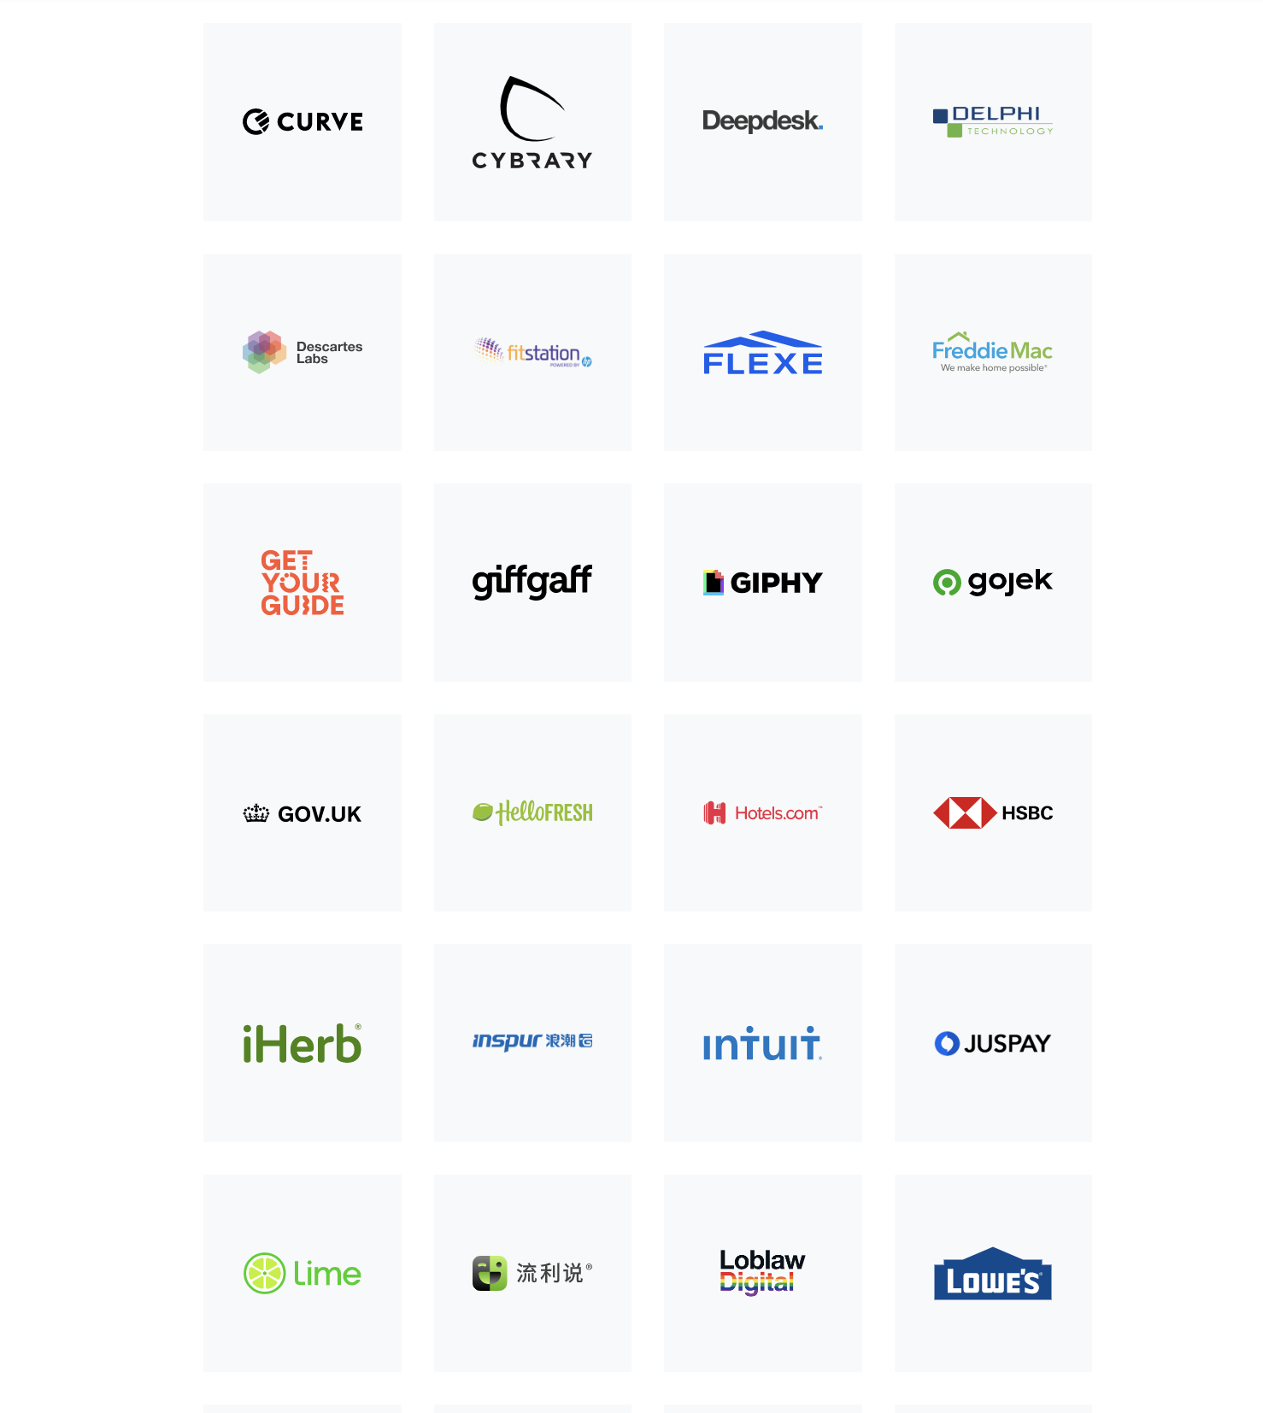
Istio Users
Reference

Slide 8
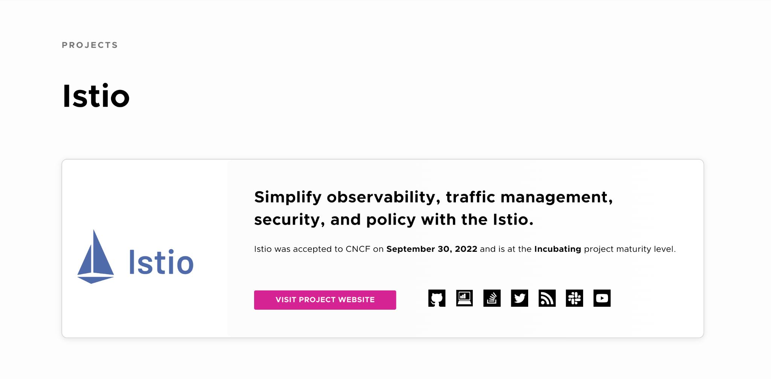
Oh - this also happened!

Slide 9
Istio 2023 Themes
Accelerating time to value for service mesh (0 → mTLS)
TCO revolution
Open Community Growth
Continue to be Boring & Predictable

Slide 10
Istio 2023 Focus Areas
Ambient mesh to production
Gateway API & GAMMA
Continue stability and feature promotions
Integration with other open source cloud native projects and standards

Slide 11
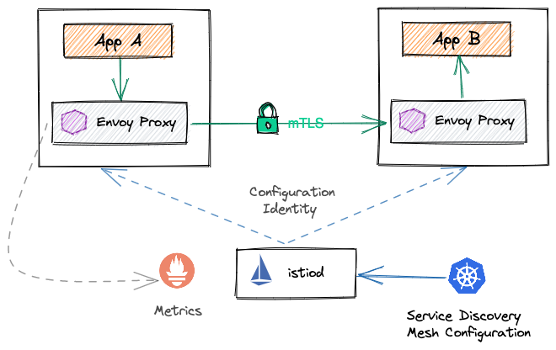
Challenges with Istio Sidecar Proxies
OPERATIONAL
COMPLEXITY
OVERHEAD
COST
PERFORMANCE

Slide 12



Istio Ambient Mesh
A recent, open source contribution to the Istio project,
that defines a new sidecar-less data plane.
Simplify
Operations
Cost
Reduction
Improve
Performance
https://istio.io/latest/blog/2022/introducing-ambient-mesh/

Slide 13
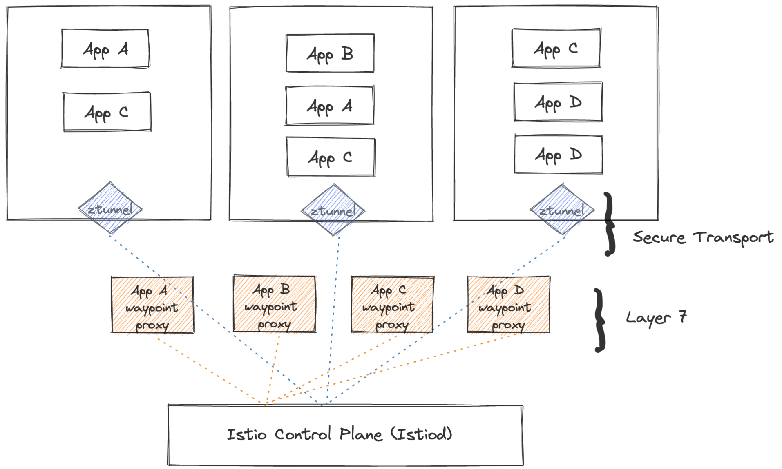
Ambient Mesh Architecture

Slide 14
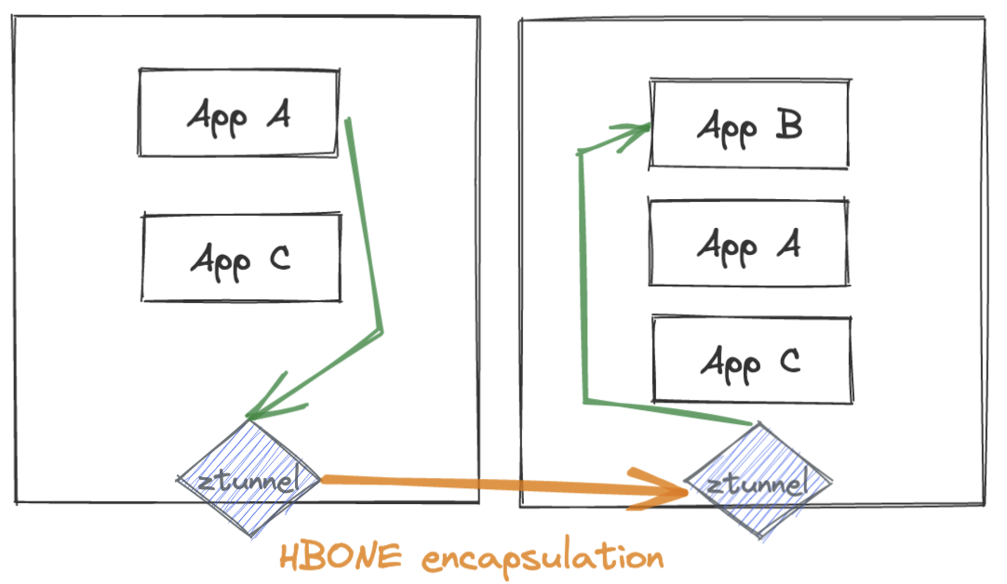
Ambient Mesh Architecture

Slide 15
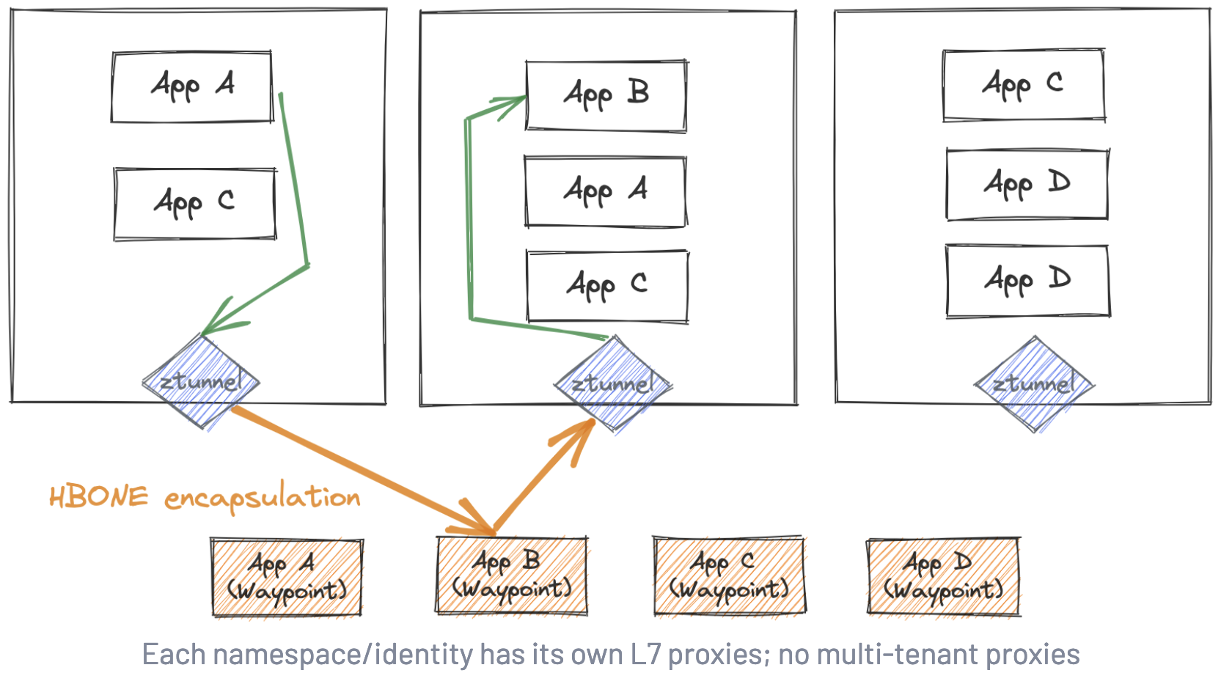
Ambient Mesh Architecture

Slide 16
Is Istio Ambient Mesh Secure?
Istio Ambient is as secure as sidecar
Reference - Ambient Mesh Security Talk

Slide 17

Can Sidecar & Ambient Co-exist?
Istio Control Plane
P
P
P
Cost Flexibility
P
P
P
P
P
P
P
P
P
Operational Flexibility
P
P
P
waypoint proxy
waypoint proxy
P
P
P
ztunnel
Performance Flexibility
Sidecar
Sidecar-less

Slide 18
How can you get involved?
Join Istio slack
Attend Istio events
Reporting bugs & security vulnerabilities
Become a code contributor
Participate in Working Group & TOC meetings
Reference

Slide 19
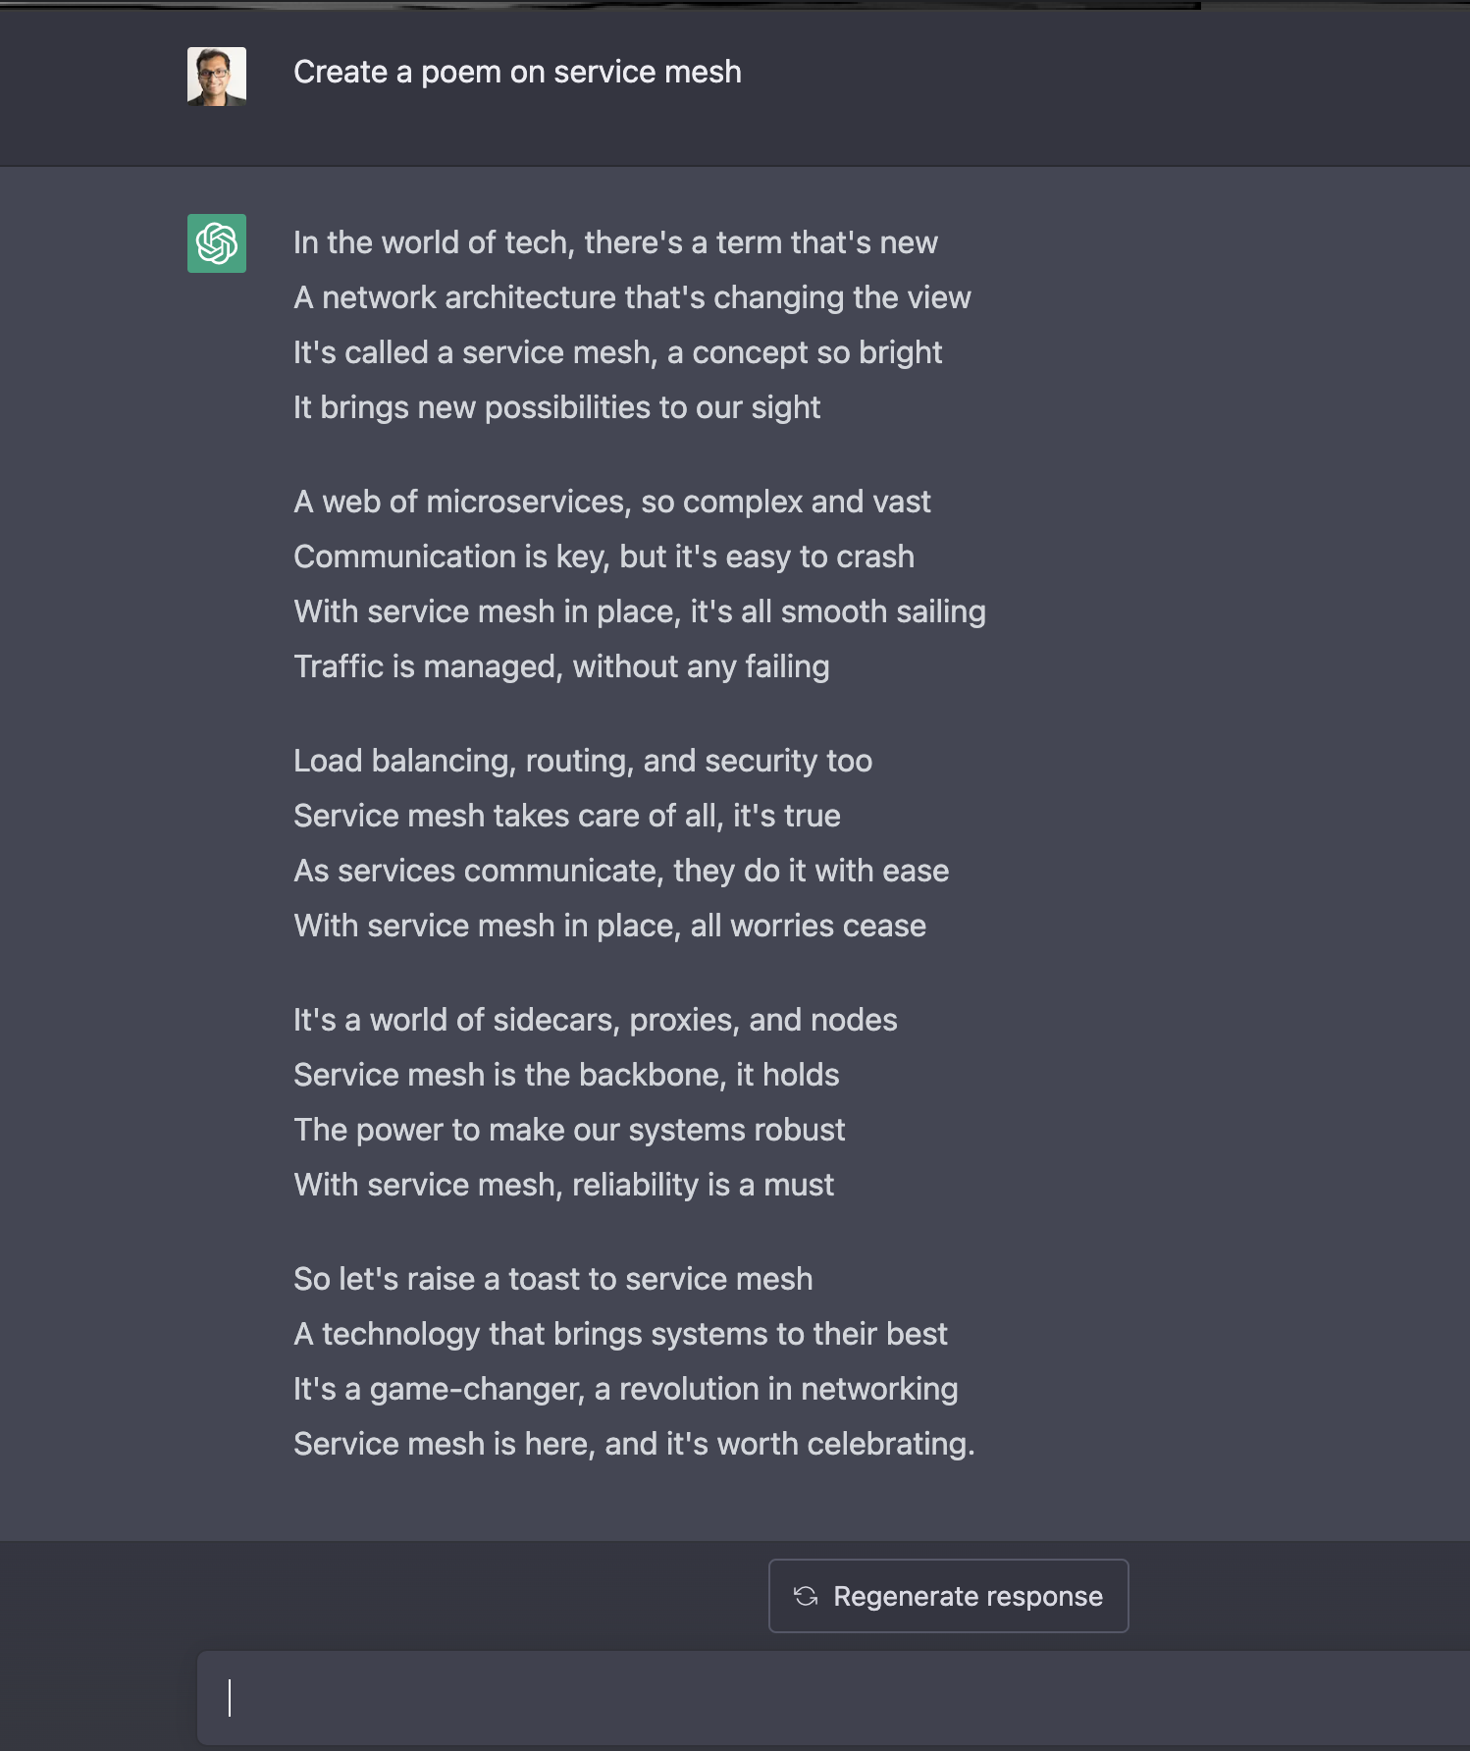

Slide 20

Session QR Codes will be
sent via email before the event
Please scan the QR Code above
to leave feedback on this session

